Slide 1
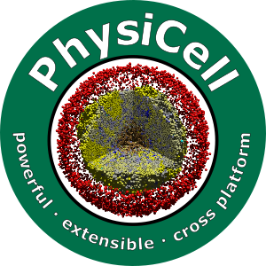

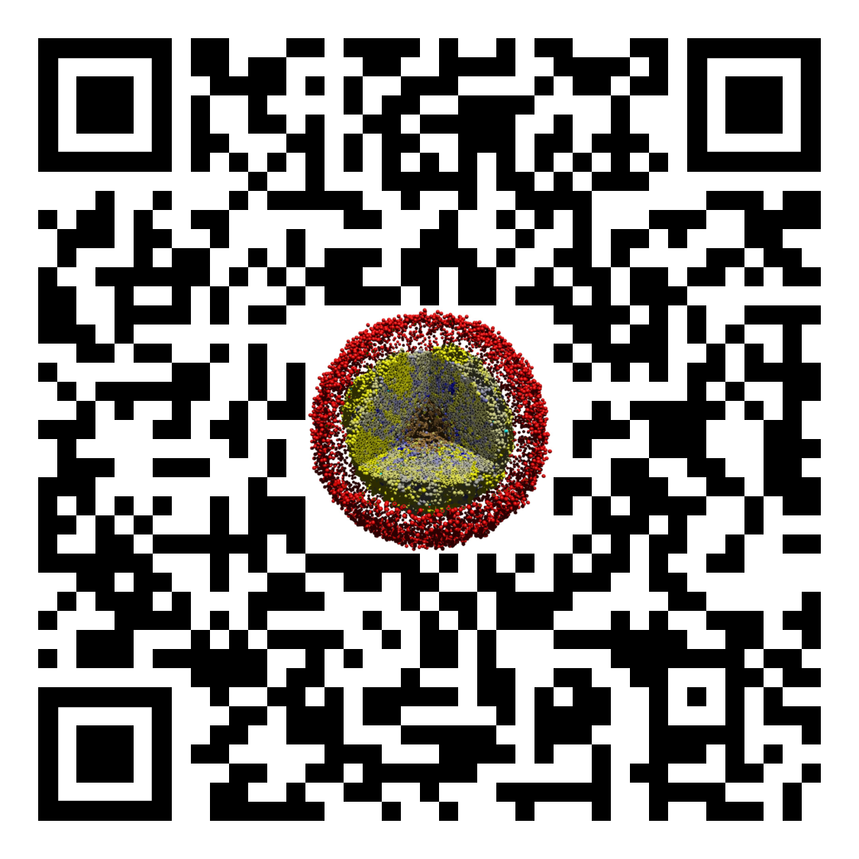
Lesson x: Module title
Slides, videos, links and more:
https://github.com/physicell-training/01-Welcome-to-training
Paul Macklin, Ph.D.
@MathCancer
last updated: August ?, 2019

Slide 2
Context
Cells
Global Variables
Substrates
Boundary Conditions
Custom Data
List of cells
Cell Functions
Domain Size
User Parameters
PhysiCell Constants
SVG options
MultiCellDS options
Default Cell Definition
Default microenvironment
Voxel Size
Cell State
Basic Agent Variables(inherited)
Cell Definition
Microenvironment
Phenotype

Slide 3
Context
Phenotype
Motility
Cell Cycle
Death
Mechanics
Geometry
Molecular
Volume

Slide 4
Background
Cells can actively move through their environment by motility.
Mathematically, this is often modeled as a biased Random walk.
Cells may ….

Slide 5
Mathematics: Variables and Definitions
Migration bias direction: plain English description
Migratation bias: plain English description …
Migration speed
(Mean) persistence time
….

Slide 6
Mathematics: Assumptions
Okay to write "no extra assumptions"

Slide 7
Mathematics: Models
How often cells change motility direction
How motility direction is chosen
How motility velocity is computed
How motility velocity is added to overall velocity

Slide 8
Demonstration
Describe the nanoHUB app for this.
Hyperlink and QR code.
Any special instructions. (We'll do a generic "how to use a nanoHUB app" in another slide deck.)
Show a screenshot or two, and a sample output.
We encourage you to open this model now while reading about its parameters.

Slide 9
Class structure: Data

Slide 10
Class structure: Methods

Slide 11
Example
dfdf
df
dfdf
dfd

Slide 12
Caveats, notes, and best practices
Okay to write "no extra notes"

Slide 13
Next steps
Super fast: Please proceed to 2 (Title… ) Link: https://github.com/physicell-training/01-What-you-need
Intermediate: Please proceed to 2 (Title …) Link: https://github.com/physicell-training/01-What-you-need
Full training: Please proceed to 2 (Title …) Link: https://github.com/physicell-training/01-What-you-need
More materials: https://github.com/physicell-training/master-list

Slide 14




Credits
Lesson Planning: Paul Macklin
Slides: Paul Macklin
Recording: Paul Macklin
Post-production: Paul Macklin, Drew Willis*, Kali Konstantinopoulos*
Microapps: not applicable
* denotes undergraduate researcher
Funding:
PhysiCell Development:
Breast Cancer Research Foundation
Jayne Koskinas Ted Giovanis Foundation for Health and Policy
National Cancer Institute (U01CA232137)
National Science Foundation (1720625)
Training materials:
* Administrative supplement to NCI U01CA232137 (Year 2)

